Slide 1
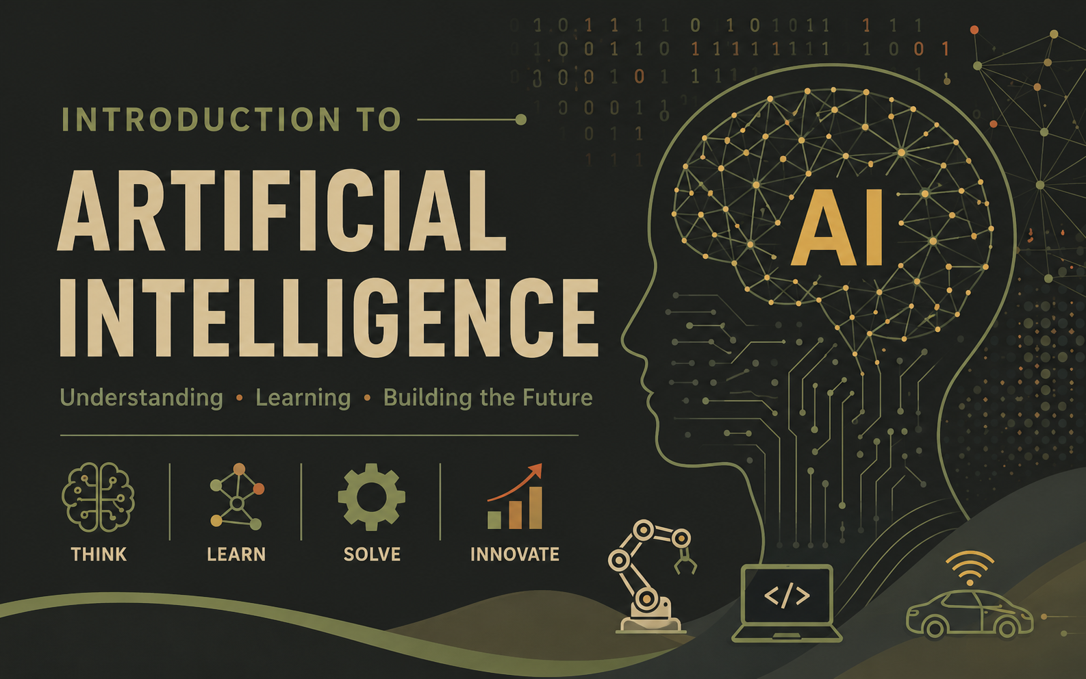


Dr. Ankit Deshmukh
Department of Civil Engineering
SoT, Pandit Deendayal Energy University
ankit.deshmukh@sot.pdpu.ac.in
www.ankitdeshmukh.com

Slide 2
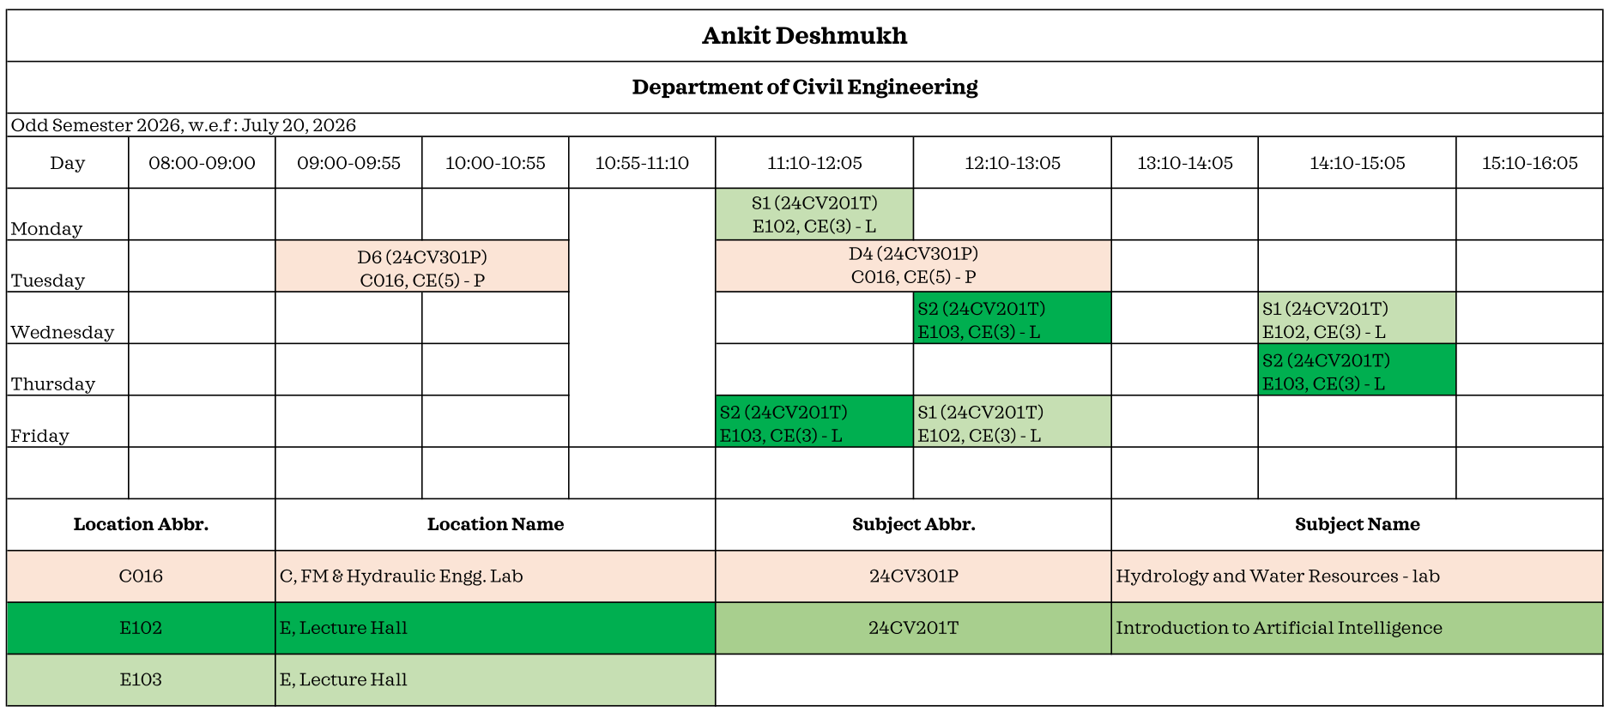
Hi, I am Ankit Deshmukh!
Office hours: Tue14:00 to 16:00
ankit.deshmukh@sot.pdpu.ac.in
D-Block Cubical C-7
ankitdeshmukh.com/
Hydrology & Water Resources Engineer
Ph.D. (IIT Hyderabad) – Climate Vulnerability & Catchment Modeling
Data Science | Python/R | Statistical Analysis
Climate Risk Assessment & Adaptation Strategies
Generative Art and Wood working
Official Communication Policy
Email is the only official mode of communication for this course.
Calls and WhatsApp will not be considered official communication channels.
Students are responsible for checking their university email regularly
Email Communication Guidelines
Use a clear subject line.
Maintain a professional format.
Write clearly and respectfully.
Send emails only from your official university email account.
Office Hours
Classroom Rules
Be on time: Students arriving 10 minutes late will not receive attendance.
Silence your phone: Keep mobile phones on silent mode.
Come prepared: Bring your laptop or notebook to every class.
Stay engaged: Take notes and actively participate in class.

Slide 3
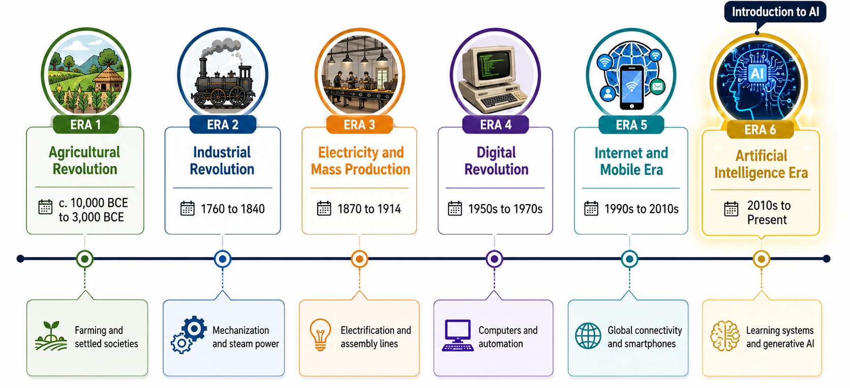
Technological Revolutions That Changed Society

Slide 4
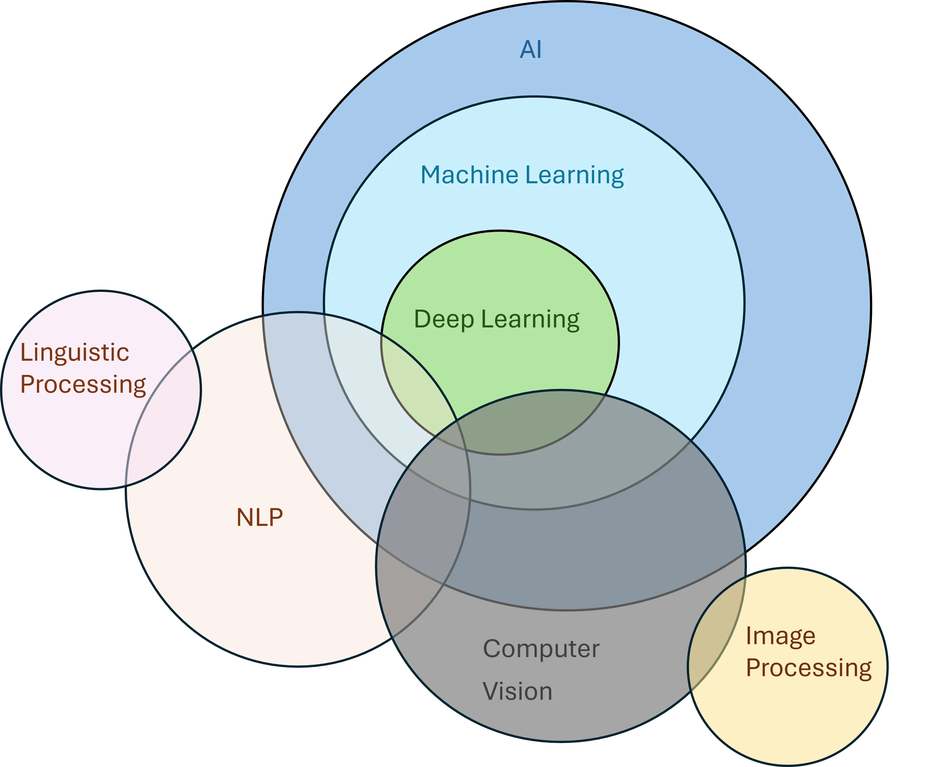
Venn Diagram showing relationship between AI, ML, DL, NLP, Computer vision
AI mimics human intelligence in machines.
Machine learning is a part of artificial intelligence where computers learn from data and improve over time without being directly told what to do.
Deep learning dives deep into data, mimicking the interconnected neurons of our brain

Slide 5
Application of AI in Civil Engineering
Structural Health Monitoring: AI models analyze sensor data to detect early damage.
Construction Scheduling: Machine learning optimizes timelines and adapts to delays.
Flood & Drought Forecasting: Hybrid AI–physics models improve water risk predictions.
Generative Design: AI explores thousands of design options for optimal efficiency.
Automated Quality Inspection: Computer-vision systems spot defects in concrete and welds.
BIM Enhancement: AI enriches Building Information Models with predictive cost and clash detection.
Traffic Flow Optimization: AI analyzes real‑time data to adjust signals and reduce congestion.

Slide 6
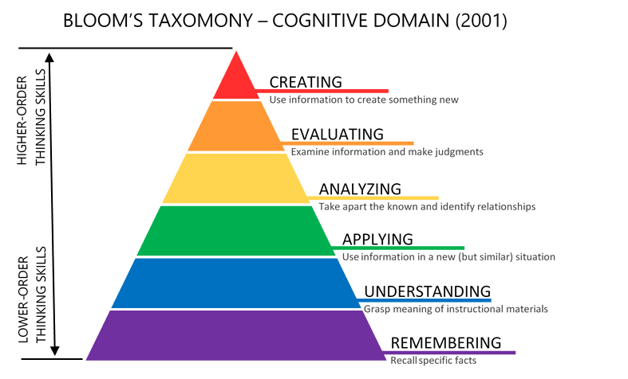
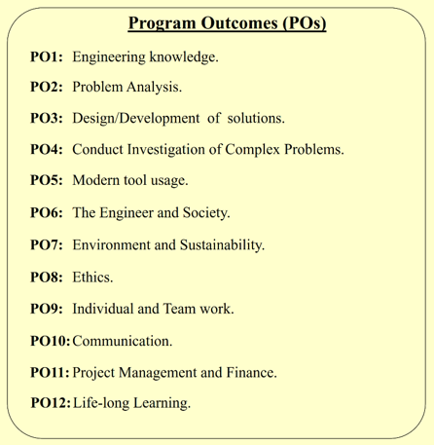
Outcome based education
educationaltechnology.net

Slide 7
Course Objectives and Structure
COURSE OBJECTIVES
Understand key concepts and applications of Artificial Intelligence (AI).
Master statistical analysis and data visualization with Python.
Gain proficiency in implementing various machine learning algorithms.
Develop practical skills in data preparation, model training, and evaluation.
Apply regression and classification algorithms to solve real-world problems.
COURSE Structure
Pandit Deendayal Energy University | School of Technology
24CV201T |  |  |  |  |  |  | Introduction to Artificial Intelligence
Teaching Scheme |  |  |  |  |  |  | Examination Scheme
L | T | P | C | Hrs./Week | Theory |  |  | Practical |  | Total
 |  |  |  |  | MS | ES | IA | LW | LE/Viva | Marks
3 | 0 | 0 | 3 | 03 | 25 | 50 | 25 | - | - | 100

Slide 8
Course Syllabus
Unit 1: Foundations of AI in Civil Engineering (8 Hours.)
AI Fundamentals & Engineering Context, Introduction to AI (Definition, Scope of Machine Learning vs. Deep Learning), Data Science Lifecycle and Workflow, Narrow AI vs. Generative AI, Foundation Models and Large Language Models (LLMs), Core Learning Paradigms (Supervised, Unsupervised, Reinforcement Learning), Civil Engineering Applications (Pavement Deterioration Analysis, Concrete Strength Prediction, Traffic Flow Forecasting, Structural Health Monitoring, Bridge Inspection Automation, Construction Safety Systems), Water Resources Applications (Flood Forecasting, Rainfall Prediction, Drought Monitoring, Groundwater Modeling), Geospatial Foundations (Land Use Classification, Flood Mapping, Infrastructure Extraction), Ethical AI (Bias Mitigation, Explainable AI/XAI, Data Privacy in Public Works).
Unit 2: Statistics and Exploratory Data Analysis (14 Hours.)
Statistics and Exploratory Data Analysis (EDA), Engineering Data Types (Numerical, Categorical, Time-Series, Spatial data), Descriptive Statistics (Mean, Median, Mode, Variance, Standard Deviation, Quartiles), Probability Foundations for Risk Assessment, Visual Analytics with ggplot2 (Scatter Plots, Histograms, Density Plots, Boxplots, Violin Plots, Heatmaps, Correlation Matrices), Data Cleaning Procedures (Handling Missing Values, Removing Duplicates, Outlier Detection), Identifying Feature Relationships, Analysis of Environmental Datasets (e.g., Rainfall Variability).

Slide 9
Course Syllabus
Unit 3: Machine Learning Workflows and Evaluation (15 Hours.)
The Machine Learning Workflow, Comprehensive Data Preparation (Data Cleaning, Normalization, Scaling, Encoding Categories), Feature Engineering for Civil Data (Calculating Rainfall Intensity, Runoff Coefficients, NDVI Anomalies), Model Training and Validation, Evaluation Metrics for Regression (RMSE, MAE, R²), Evaluation Metrics for Classification (Accuracy, Precision, Recall, F1 Score, ROC Curves), Statistical Challenges (Overfitting vs. Underfitting, Bias-Variance Tradeoff), Cross-Validation Techniques.
Unit 4: Advanced Modeling and Civil Engineering Applications (15 Hours.)
Machine Learning Algorithms & Geospatial Engineering, Regression Models (Linear Regression for Structural Design, Logistic Regression for Failure Prediction), Tree-Based Models (Decision Trees, Random Forests for Flood Susceptibility and Crop Yield), Proximity and Probability Models (K-Nearest Neighbors, Naive Bayes), Clustering Techniques (K-Means and Hierarchical Clustering for Regional Analysis), Geospatial Data Structures (Raster vs. Vector data, Satellite Image Processing), Remote Sensing Integration (GIS + AI Fusion), Advanced Mapping Applications (Urban Heat Island analysis, Landslide Mapping, River Change Detection).

Slide 10
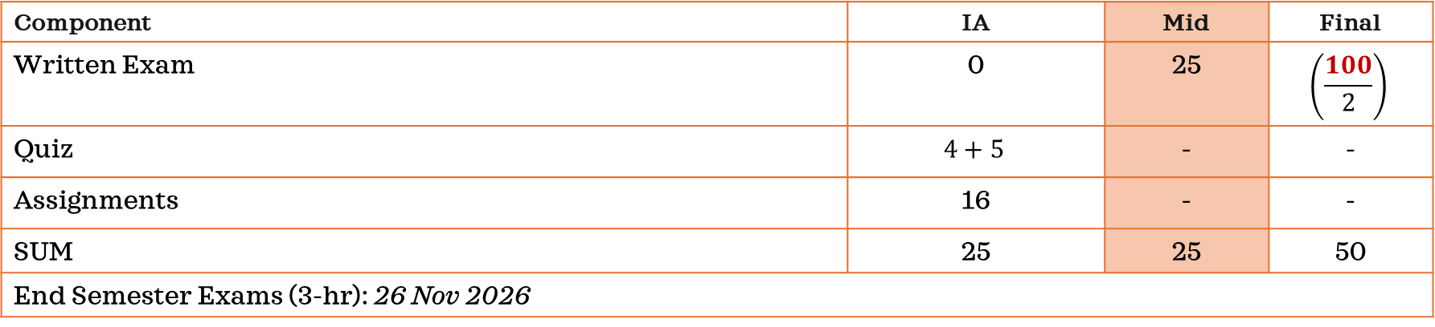
Evaluation for this semester
Component | IA | Mid | Final
Written Exam | 0 | 25 | $$\left(\frac{100}{2}\right)$$
Quiz | $$4+5$$ | - | -
Assignments | 16 | - | -
SUM | 25 | 25 | 50
End Semester Exams (3-hr): 26 Nov 2026
Mid sem exam: 6 questions (4*5) + (2*2.5) : 25
IA: 3 quiz 3 marks each and 4 assignment 4 marks each : 25
End sem exam: 10 questions (10*10) : 50
if(END ≥ 35 && TOTAL ≥ 40){ "Pass" } else { "Fail" }

Slide 11
Reference books
Russell & Norvig – Artificial Intelligence: A Modern Approach (Concepts)
James et al. – Introduction to Statistical Learning (Machine Learning)
Wickham et al. – R for Data Science (Practical R Programming) R for Data Science (2e)

Slide 12
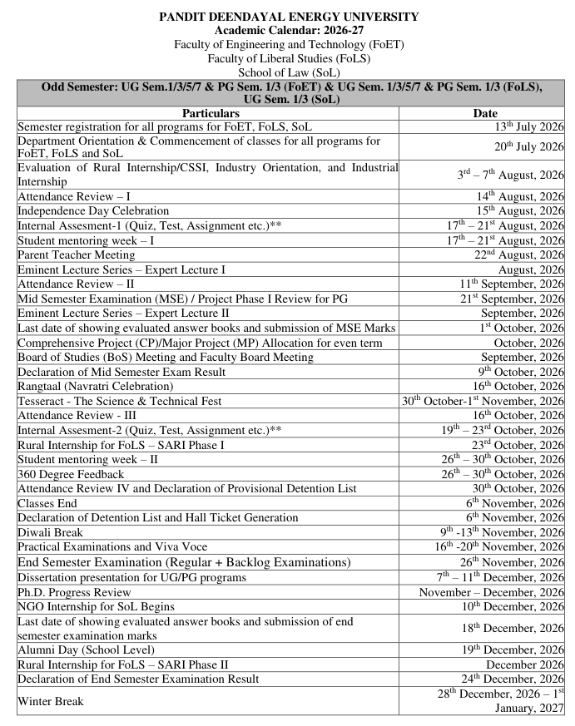
Academic Calendar and Links
IoAI Theory Handouts:
See your attendance and Marks:
[Sample Link]
# Class Representative(s)
------------------------------------------------
S1:
S2:

